Slide 1
Go term visualisations
Jochum, Michael D.
27 Oct 2020

Slide 2
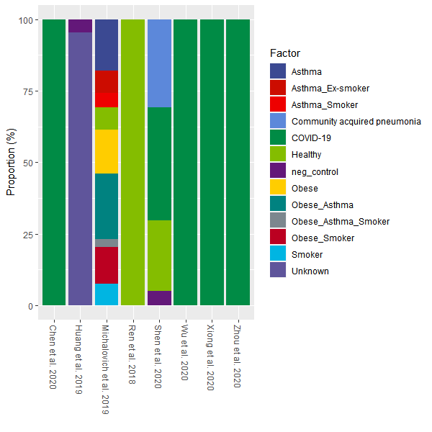
Proportion of samples types by publication

Slide 3
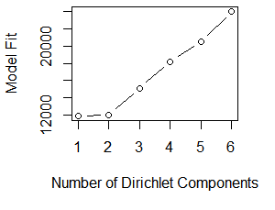
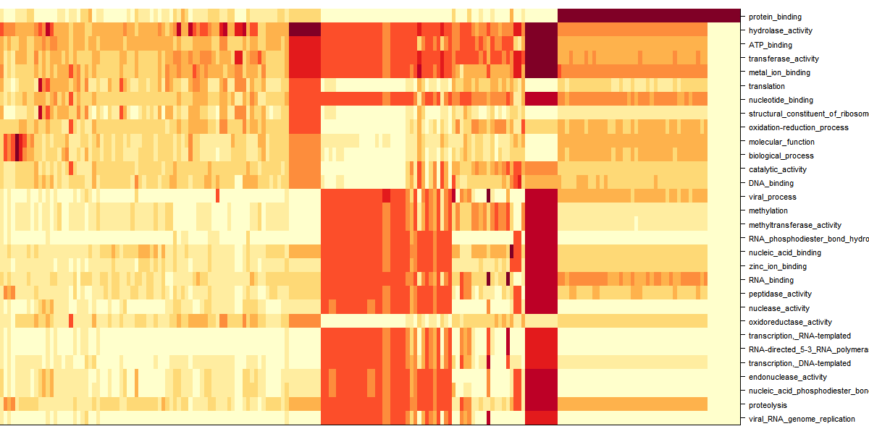
Dirichlet Multinomial Mixtures Community typing

Slide 4
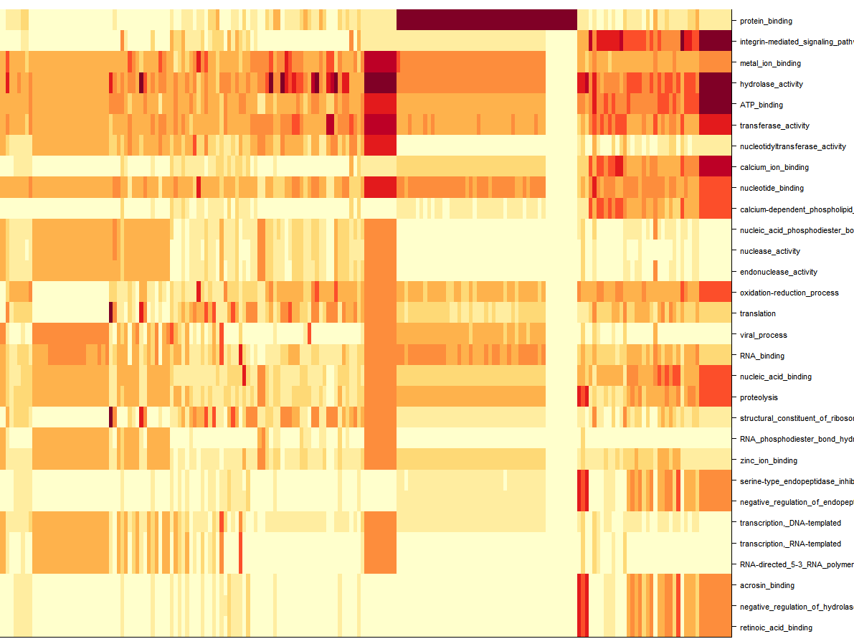
Dirichlet Multinomial Mixtures Community typing

Slide 5
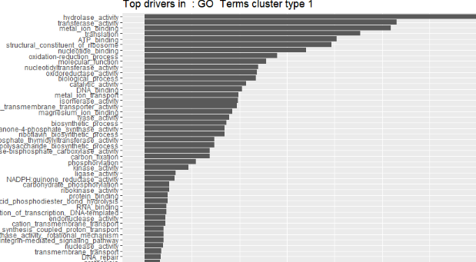
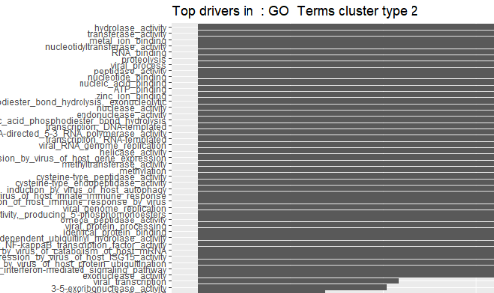
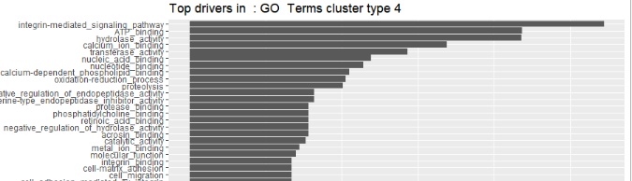
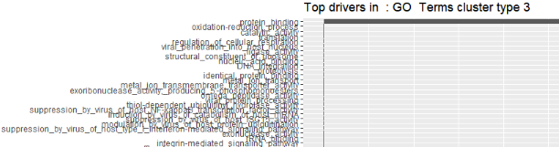
Dirichlet Multinomial Mixtures Community typing

Slide 6
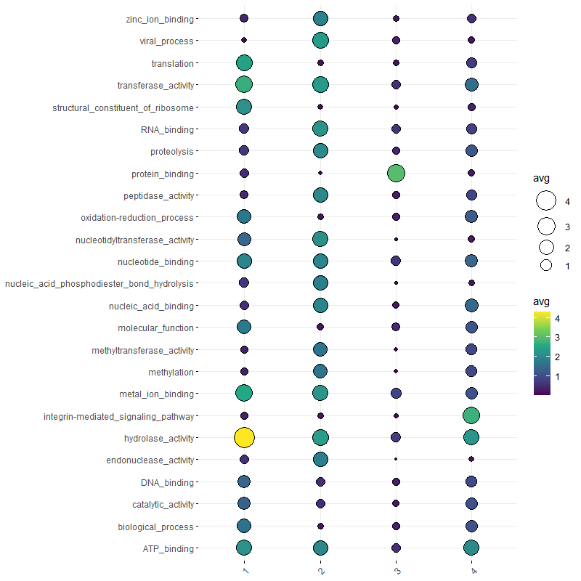
Dirichlet Multinomial Mixtures Community typing

Slide 7
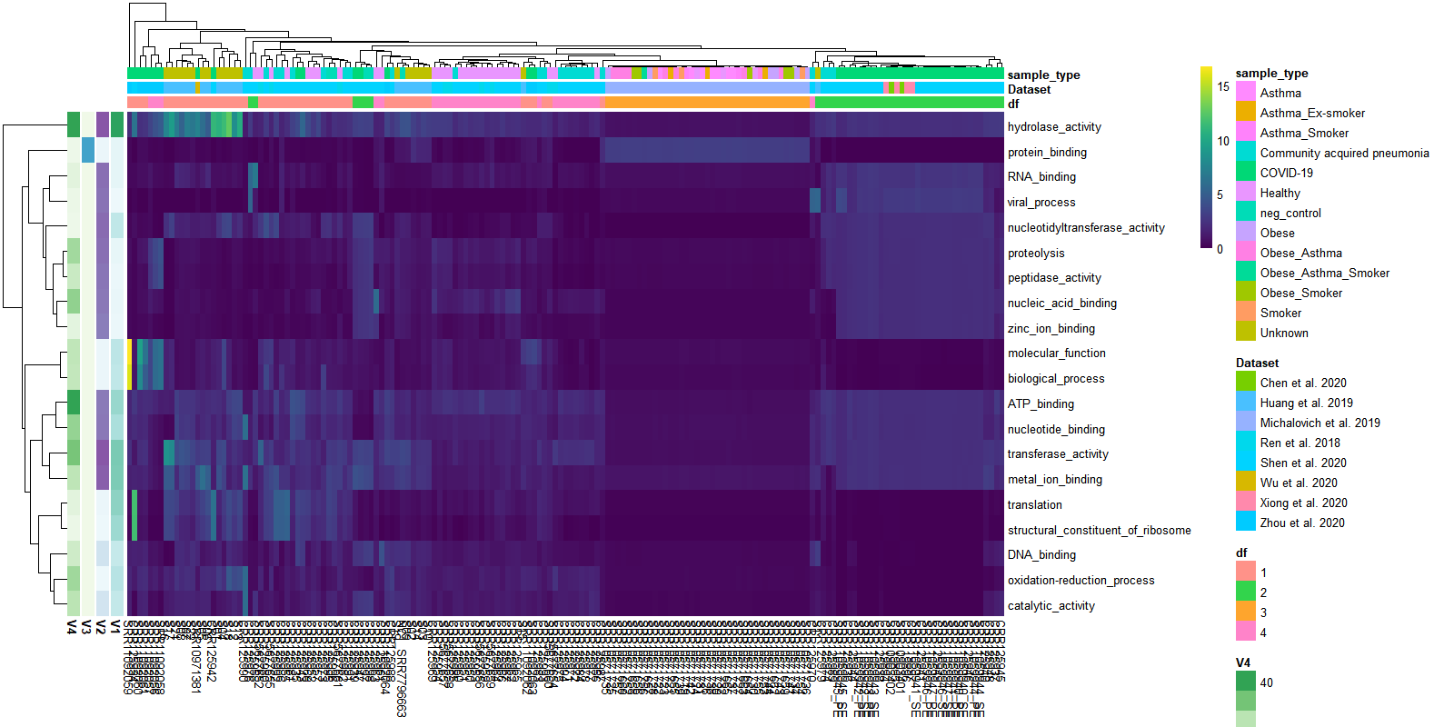
Dirichlet Multinomial Mixtures Community typing

